Slide 1
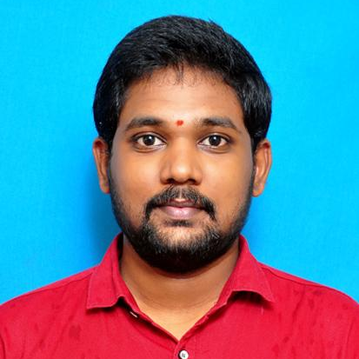



GUNDABATTULA CHAITANYA VISHNU SAI
Analyst/Software Engineer
Bachelor of Engineering
Electrical and Electronics: 2018- 2022
Skills
Bangalore
Java 8 /J2EE | Java Basics, OOPS, Collections, Arrays, Loops, Stream API Junit, Mockito, Servlets.
Spring core | Dependency Injection, Autowire.
Spring REST | REST controllers, Implementation of GET, POST, PUT & DELETE, Controller & Repository layer.
Spring Data JPA | Implement DAO layer using spring Data repositories.
Spring Boot Microservices | Spring Boot Starters, annotations, Swagger API specifications.
Spring Cloud | Eureka, Netflix Hystrix.
React | Components, Hooks, Event handling.
Database | MongoDB No SQL Basics
UI Tech | HTML 5 & CSS 3,JavaScript, ES6 & TypeScript Reusable templates, Optimized UI Designed
Tools | Git, Postman, Intellij.
Add On skills | Communications, Team management. Peer learning.
chaitanyavishnusai123@gmail.com
9908530800
A4
FULL STACK DEVELOPER
Hands on experience in creating Microservices and also Monolithic applications with Spring boot, Spring Security, Spring Cloud API Gateway, Eureka Discovery server.
Hands on experience in building web pages using HTML, CSS, Bootstrap, React.
Development experience using Eclipse, VS Code, IntelliJ Idea, Postman as API client, Pg Admin for Postgres Database and MongoDB Atlas.
Shopping Cart System Application
Completed end to end case study of Shopping Cart System along with JWT authentication, responsive UI with HTML, CSS and ReactJs used for user interface and MongoDB as the Database.
Employee Management Application
Developed backend applications using Monolithic Architecture and implemented all the CRUD operations using Spring Boot, Postgres, Postman and ReactJs for UI.
Check out my work on GitHub & Video Profile

